Slide 1

Predicting Risk Diabetes Type II
Job Connector Data Science and Machine Learning Purwadhika JCDS-0406
DINA NADHIRAH

Slide 2
Types of diabetes
Type 1 diabetes.
The pancreas produces no insulin.
Type 2 diabetes.
The pancreas doesn’t make enough insulin or your body can’t use it effectively.
The CDC notes that 90 to 95 percent of diagnosed cases are type 2 diabetes.
Gestational diabetes.
Expectant mothers are unable to make and use all of the insulin they need during pregnancy.

Slide 3
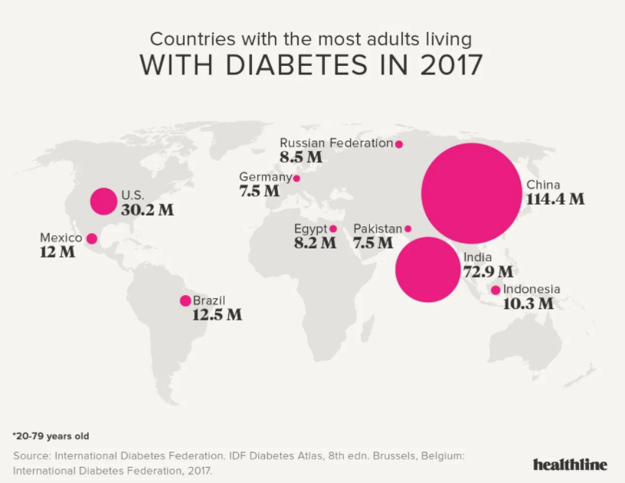

Slide 4
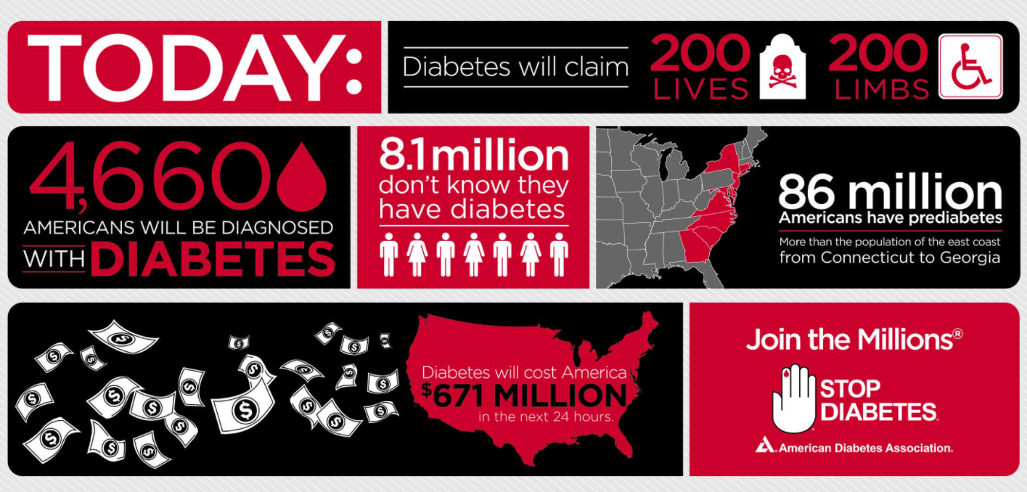
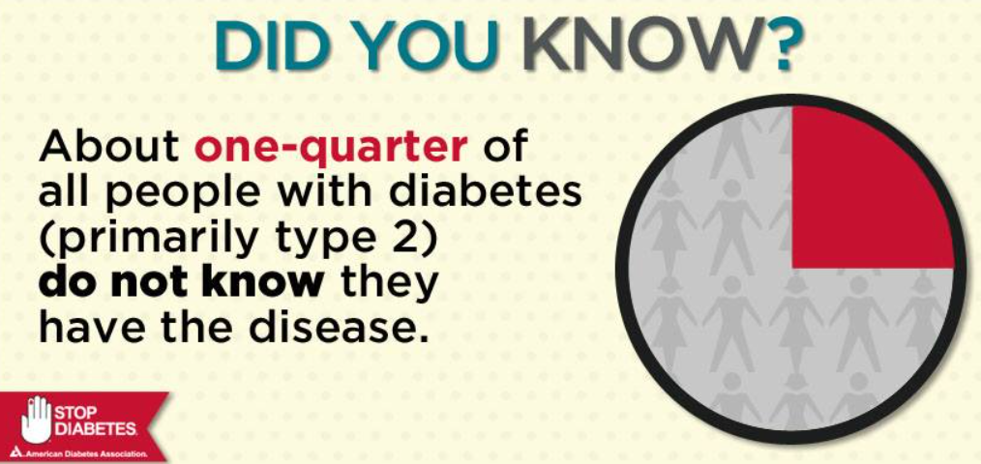
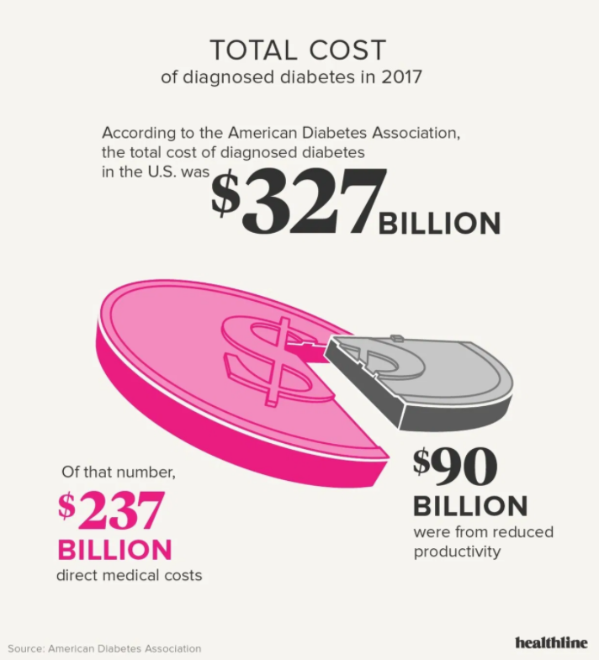
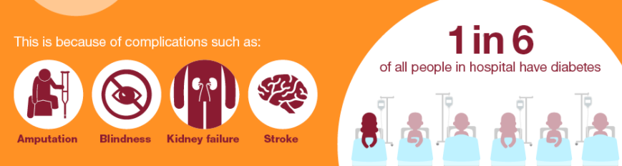

Slide 5
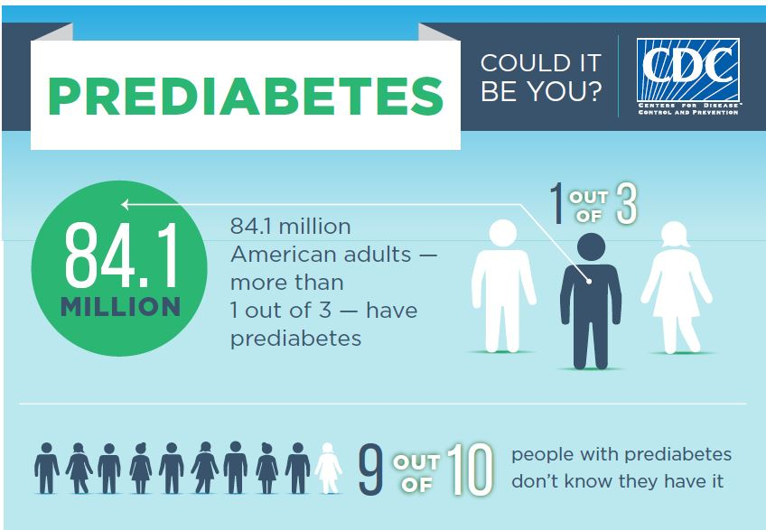
Prediabetes
Blood glucose levels are higher than what’s considered normal, but not high enough to qualify as diabetes.
Source Data : https://wwwn.cdc.gov/media/release/2017/p0718-diabetes-report.html

Slide 6
Objective
Prediction risk diabetes
Prediction risk prediabetes/undiagnosed diabetes

Slide 7
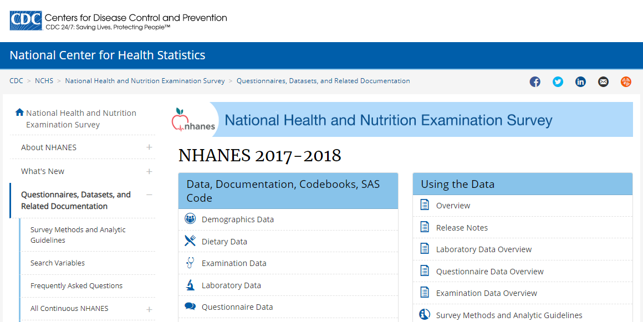
Source Data : https://wwwn.cdc.gov/nchs/nhanes/continuousnhanes/default.aspx

Slide 8
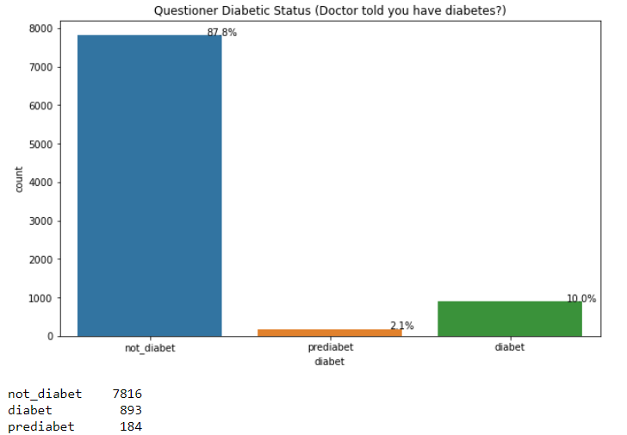
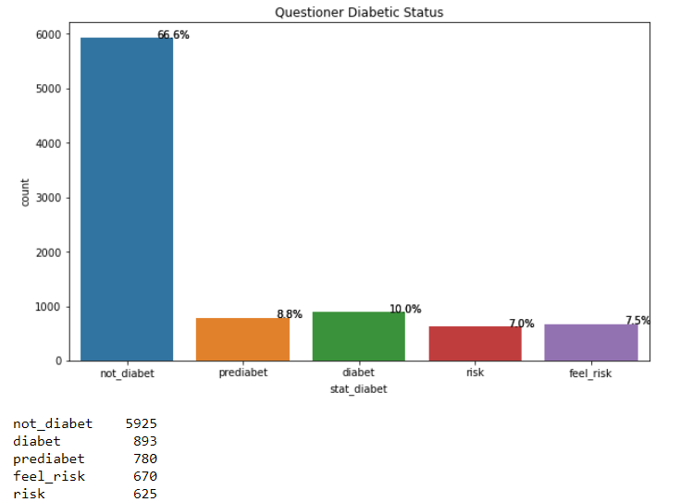
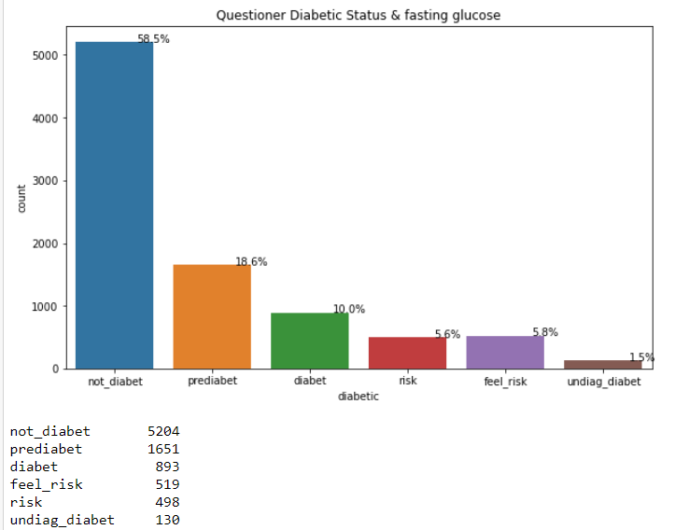
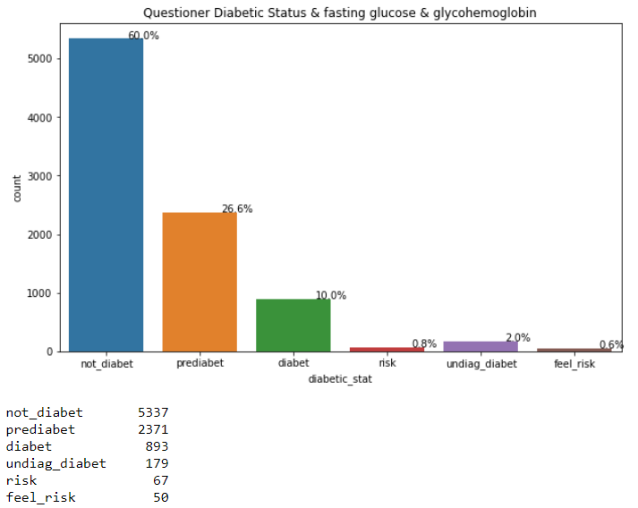

Slide 9
Selecting Features
Criteria Selecting Features | Case1 (Risk Diabetes) | Case2 (Risk Prediabetes/ Undiagnose Diabetes)
Minimal Missing Values Peforma Model Minimal Features which does not reduce the model's performance | arthritis | arthritis
 | diabetic_relative | overweight
 | overweight | diabetic_relative
 | high_bp | high_bp
 | high_chol | high_chol
 | systolic | systolic
 | bmi | bmi
 | arm_circumference | WH_ratio
 | WH_ratio | glucose_mg/dL
 | vigorous_recreational_activities | vigorous_recreational_activities
 |  | arm_circumference

Slide 10
Selecting Features FAT
Criteria Selecting Features | Case1 (Risk Diabetes) | Case2 (Risk Prediabetes/ Undiagnose Diabetes)
Minimal Missing Values Peforma Model Minimal Features which does not reduce the model's performance | arthritis | arthritis
 | diabetic_relative | overweight
 | overweight | diabetic_relative
 | high_bp | high_bp
 | high_chol | high_chol
 | systolic | systolic
 | bmi | bmi
 | arm_circumference | WH_ratio
 | WH_ratio | glucose_mg/dL
 | vigorous_recreational_activities | vigorous_recreational_activities
 | head%_fat | Head%_fat
 | trunk%_fat | arm_circumference

Slide 11
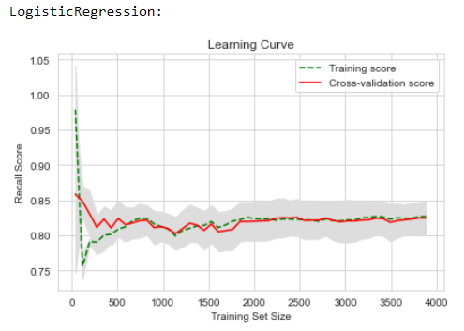
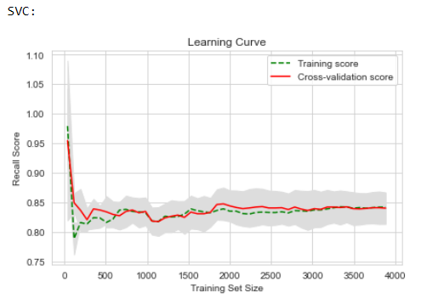
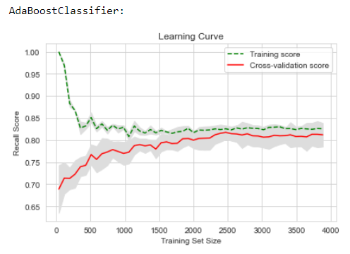
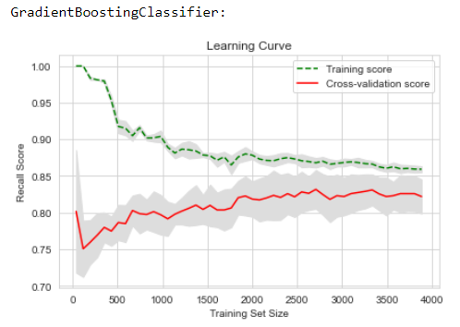
Case 1
 | Recall risk diabetic | Precision risk diabetic | Accuracy
Logistic Regression | 0.90 | 0.68 | 0.70
SVM | 0.90 | 0.68 | 0.69
Gradient Boosting Classifier | 0.90 | 0.69 | 0.70
AdaBoost | 0.90 | 0.68 | 0.69

Slide 12
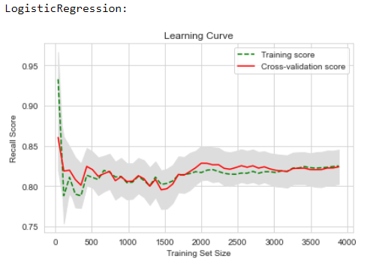
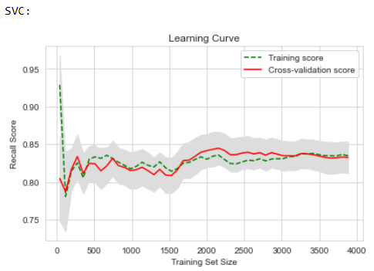
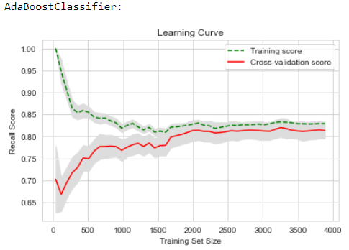
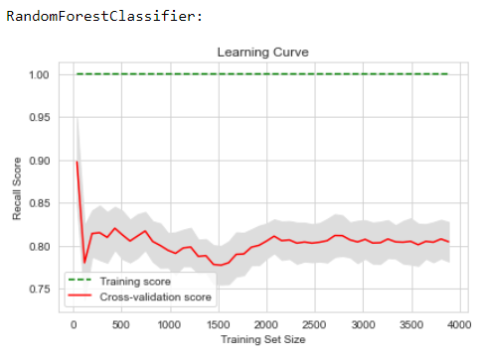
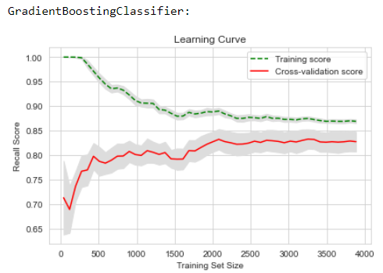
Case 1 FAT
 | Recall risk diabetic | Precision risk diabetic | Accuracy
Logistic Regression | 0.90 | 0.68 | 0.70
SVM | 0.90 | 0.68 | 0.69
Gradient Boosting Classifier | 0.90 | 0.69 | 0.70
AdaBoost | 0.90 | 0.68 | 0.69
Random Forest Classifier | 0.90 | 0.68 | 0.69

Slide 13
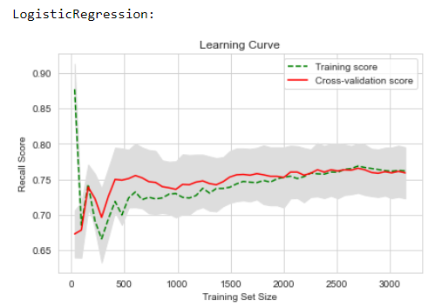
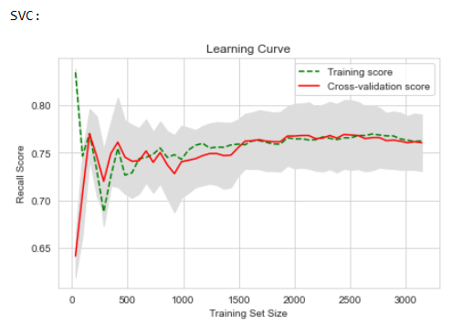
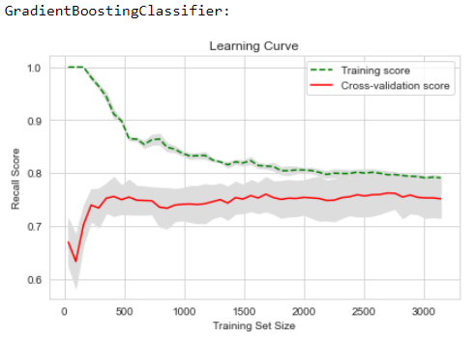
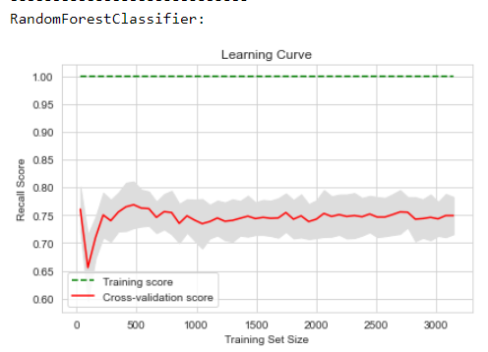
Case II
 | Recall prediabetic/ undiagnosed diabetic | Precission prediabetic/ undiagnosed diabetic | Accuracy
Logistic Regression | 0.80 | 0.54 | 0.53
SVM | 0.92 | 0.64 | 0.68
Random Forest | 0.92 | 0.66 | 0.71
Gradient Boosting Classifier | 0.90 | 0.64 | 0.68

Slide 14
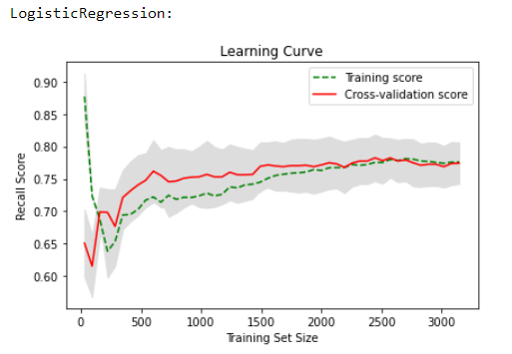
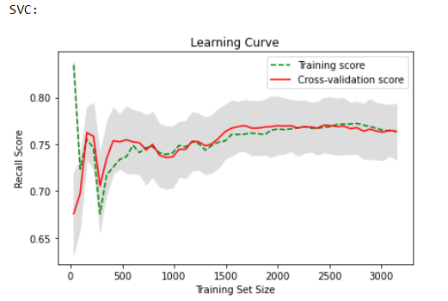
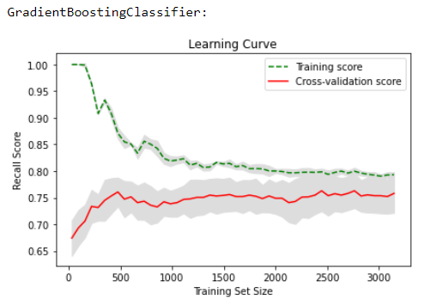
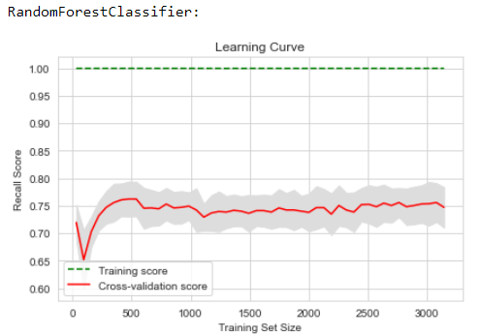
Case II FAT
 | Recall prediabetic/ undiagnosed diabetic | Precission prediabetic/ undiagnosed diabetic | Accuracy
Logistic Regression | 0.90 | 0.55 | 0.56
SVM | 0.92 | 0.64 | 0.68
Random Forest | 0.90 | 0.66 | 0.70
Gradient Boosting Classifier | 0.90 | 0.62 | 0.66

Slide 15
SuMMARY
Part Highlight :
- Normal and underweight can be risk diabetes/prediabetes/undiagnosed diabetes
- Percentage of prediabetes/undiagnosed diabetes data : 28.6%
- Prediabet can take diabetic pill for prevent or delay diabetes
Recommendation :
- Glucose Biochemistry Profile for predicting prediabetes/ undiagnosed-diabetes (requires further analysis)
- Add amount of data (from previous years but be careful with data duplication)
- Multinomial Classification

Slide 16
SuMMARY
Recommendation :
- Feature Engineering in data physical activity, nutrition, diet
- Predict risk hypertension from data NHANES
- Data trunk% fat and head% fat may be can predict risk diabetes/ prediabetes

Slide 17
THANK YOU

Slide 19
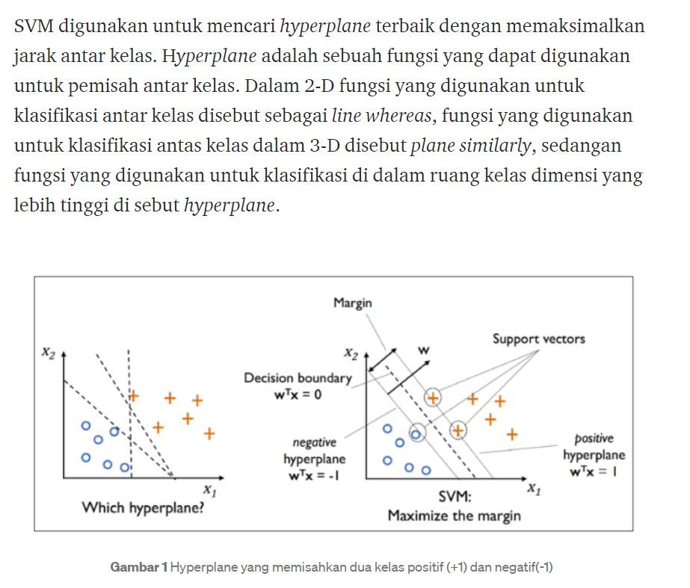

Slide 20
